Slide 1

Data Bootcamp Final Project Presentation
Lucy Ihemeje

Slide 2

About Me
I came from a background in hospitality management, however after the pandemic I started to explore other career options that would fulfil my desire to continuously learn and be a part of something innovative.
My milestones this year have been completing my prince2 certification and completing the Niyo bootcamp
The bootcamp has given practical project management and data analytics experience .
I've explored tools such as Trello, Jira, Mira and Airtable for project management and learned about database and analysing data
I studied relational database, data types, data definition, foreign keys, data cleaning and manipulation with Excel using functions such as VLOOKUP, COUNT, SUM, AVERAGE and more.
I analysed data using SQL commands such as GROUP BY, WHERE, CASE WHEN, BETWEEN, AND, aggregations, joins and windows functions to retrieve data based on a specific criteria. All of which will be demonstrated in the next few slides.
We also looked at Python, touching on PyCharm, Anaconda and Jupyter notebooks. We used Google Colab to write and execute code.
Notes:
….I am excited about graduating from the Data Analytics boot camp.

Slide 3
Objectives
The aim of this project is to explore factors that may have an effect of life expectancy in different countries.
Over the next few slides, we will look at life expectancy in various countries, factors that may affect life expectancy and explore areas of possible solutions to tackle these factors.

Slide 4
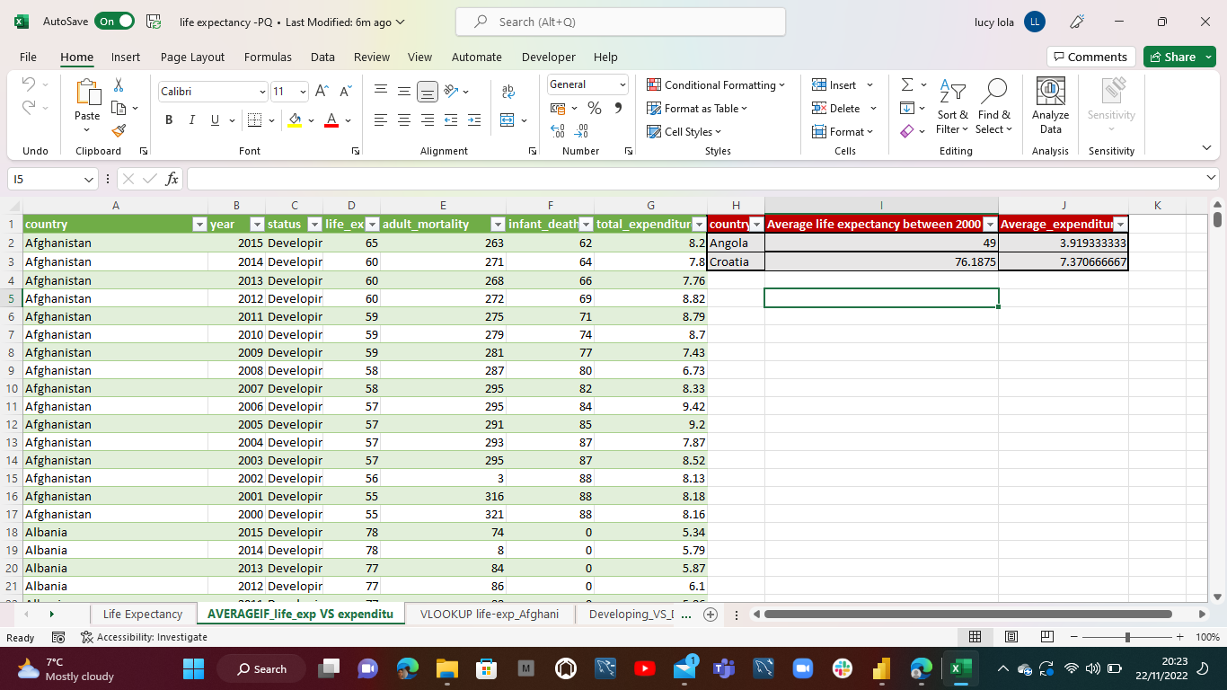
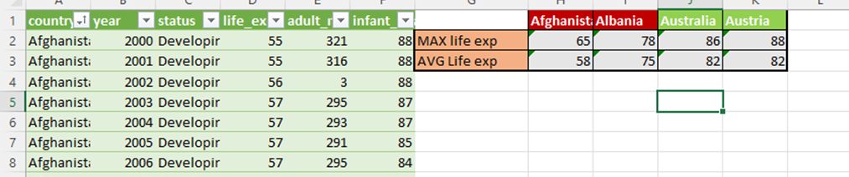
Excel Findings
Using AVERAGEIF function I explored average life expectancy and average total expenditure for Various countries to determine the correlation. The majority of countries with higher average total expenditure had better average life expectancy
Using the MAX and AVERAGE functions, I was able to find the Maximum life expectancy and Average Life expectancy in countries with Different status (Developed and Developing). I found that the developed countries on average had a higher life expectancy than the developing countries.

Slide 5
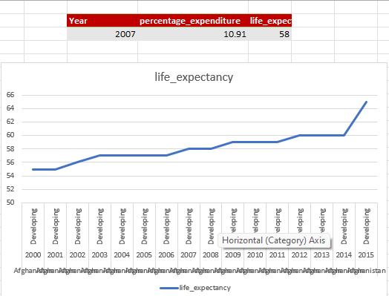
Excel Findings
Using VLOOKUP, I focused an Afghanistan, a developing country, and explored Life expectancy VS percentage expenditure for Afghanistan over the years. Over the years, as percentage expenditure increased so did life expectancy

Slide 6
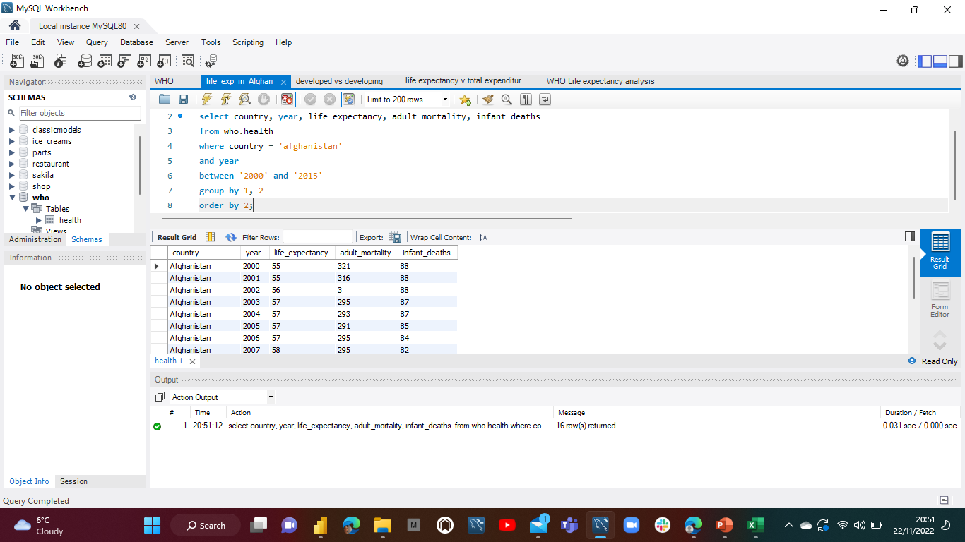
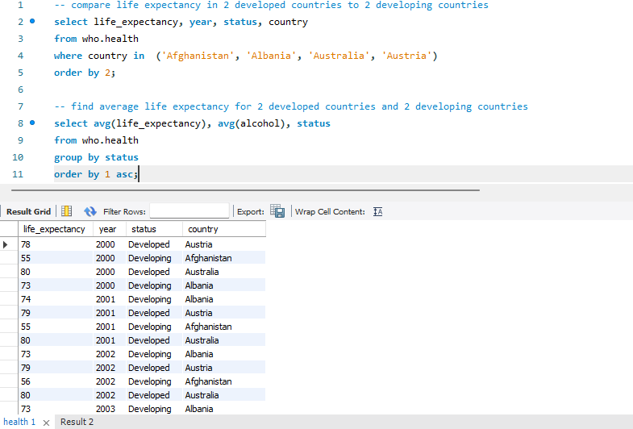
SQL Analysis
Life expectancy in Afghanistan between 2000 and 2015 using ‘Where’ and ‘Between’ clause
Difference in Life expectancy between developed and developing countries using ‘Where’, ‘Order by’ and Aggregations to return average values

Slide 7
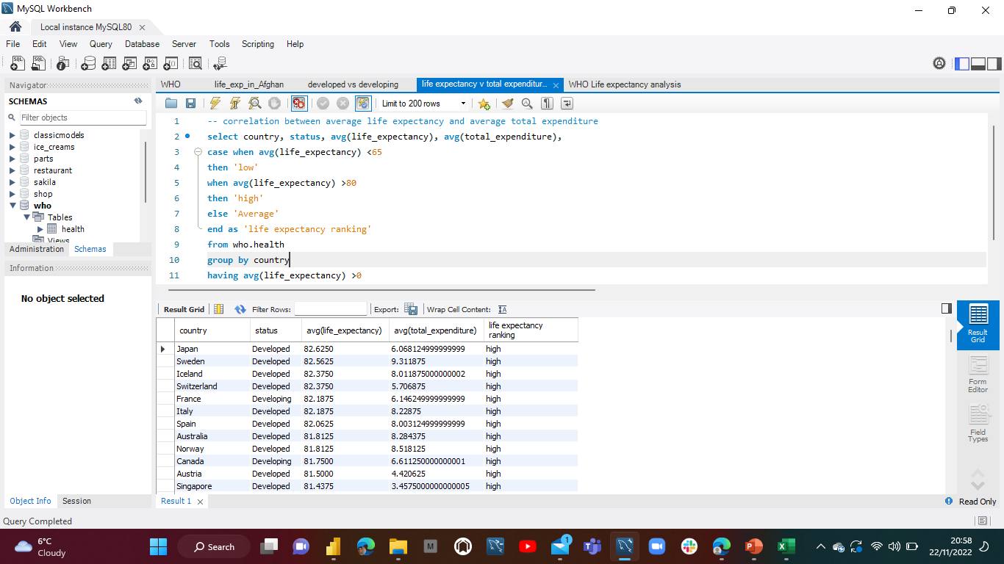
SQL Analysis
Correlation between average life expectancy and average total expenditure across various countries using ‘Case when’

Slide 8
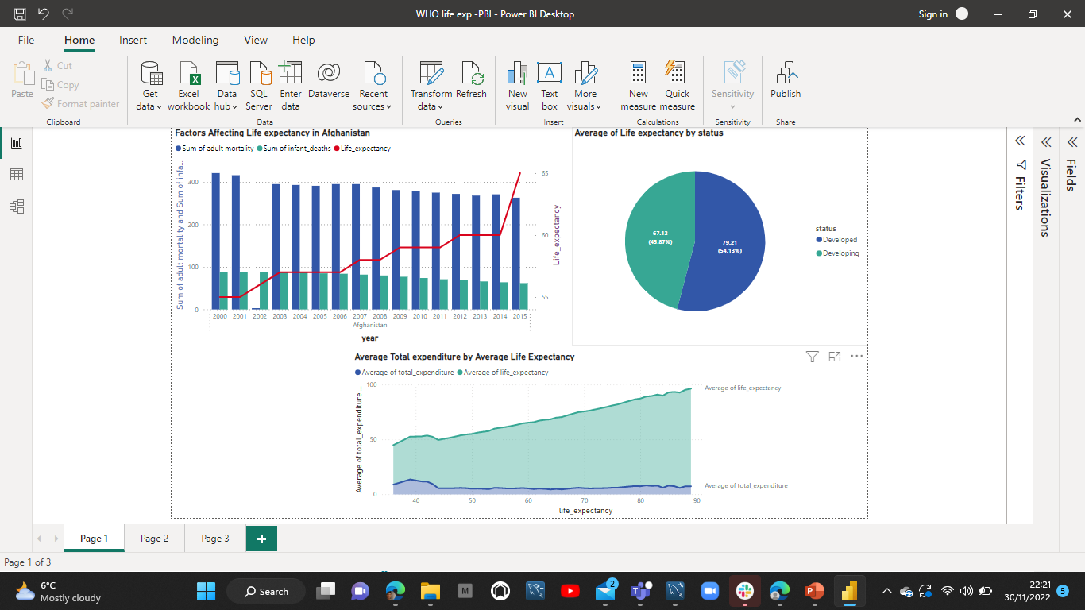
Dashboard

Slide 9



Recommendations/Insights
There is a direct correlation between a country's status and average life expectancy – average life expectancy is significantly less in developing countries
As demonstrated with Afghanistan, a decrease in Infant deaths and Adult Mortality will positively impact life expectancy
An increase in General government expenditure on health could impact life expectancy positively – it is a recommended area of focus for countries impacted.

Slide 10
Challenges
I encountered some challenges creating my visualisation using tableau. I found that I was unable to save my visualisations and attempted to download it for use in my presentation, however, the dashboard was not viable for presenting.
I worked around this by using PowerBi to create a visualisation for my data.

Slide 11
Conclusion and Key Learnings
Educational
learnt how to use Excel to manipulate data
Explored SQL
Learn how to interpret data
Personal
Learn to believe in my abilities
Increased confidence that I can achieve my goal
I enjoy learning
Career wise
Apply for the job
Continue learning

